Slide 1

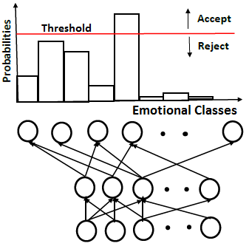
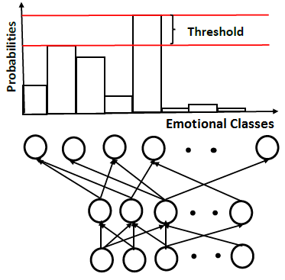


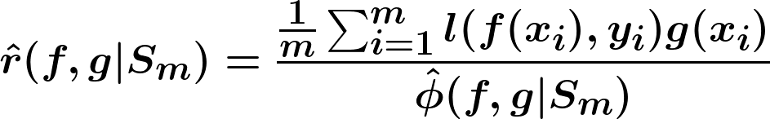
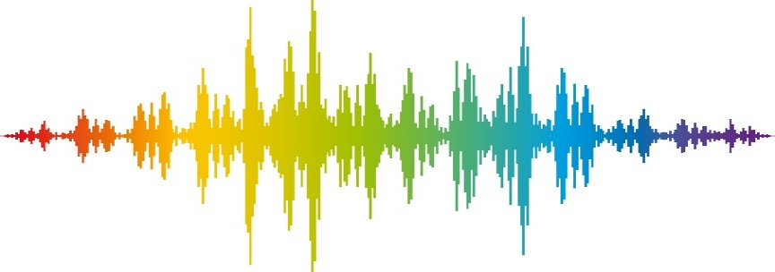

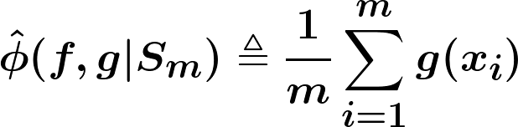




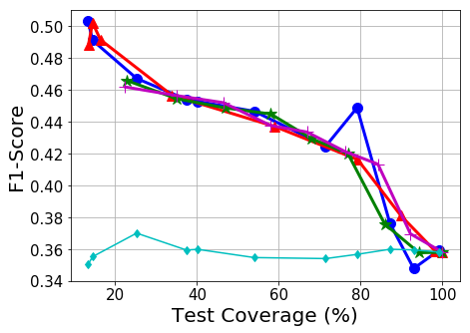
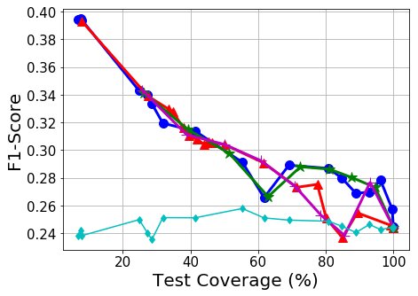
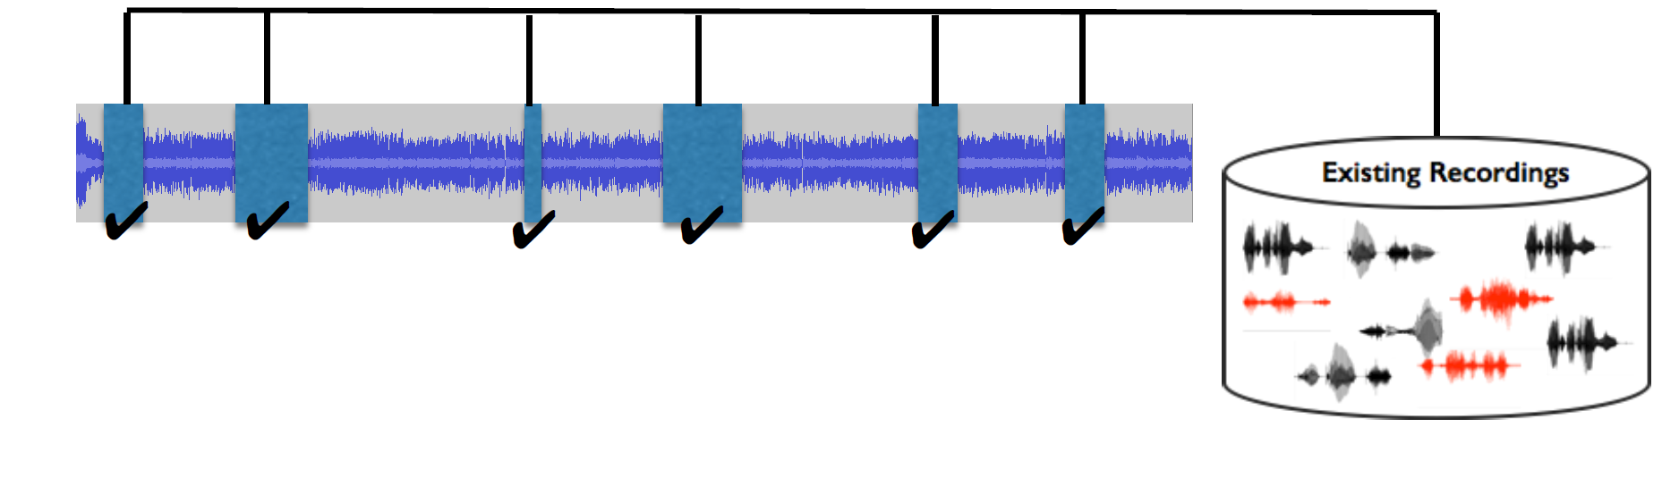
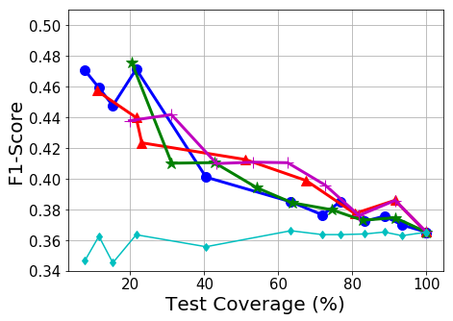
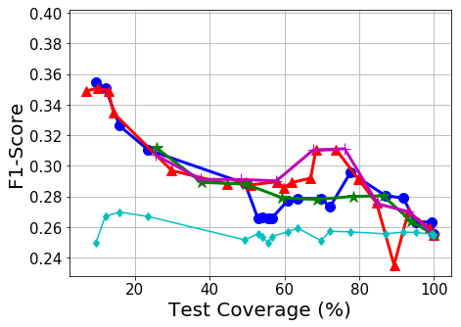
Speech Emotion Recognition with a Reject Option
Kusha Sridhar, Carlos Busso
Erik Jonsson School of Engineering & Computer Science at the University of Texas at Dallas, Richardson, Texas 75080, USA
Motivation
Reject Option for SER
Abstaining from prediction when in doubt helps application specific tasks
Selective classification on images have led to very low error rate (2%) for a test coverage of 60%
To accept or reject an instance – Apply threshold on softmax output / model the output uncertainty of the network
Our Work
SER system with a reject option
Accept or reject a sample based on the confidence of the classifier
Defined thresholds to interpret the confidence
Classifier performance improved while maintaining a high test coverage
Defining Thresholds
Criterion 1:
Threshold on the neuronal activations
SGR algorithm
Learn optimal risk bound on the classifier
Threshold on softmax outputs to achieve
a desired error rate with high confidence
Optimization
Empirical risk of classifier using SGR algorithm
F1-Score
Reject
;
DNN
Accept
Criterion 2:
Threshold on difference between
two highest prediction values
Large difference → clear prediction → accept
Database and Features
Results
Analysis & Conclusion
The MSP-Podcast Corpus
Emotionally rich speaking turns from speakers appearing in various podcasts (2.75s – 11s)
Annotated for primary and secondary emotions on Amazon mechanical Turk.
V1.4: 33,262 utterances with emotional labels (56h 29m)
Train set: 19,707 segments
Test set: 9,255 segments from 50 speakers
Validation set: 4,300 segments from 30 speakers
Acoustic Features
Interspeech 2013 Computational Paralinguistic Challenge feature set (6,373 features)
5 classes
(Happy, Neutral, Sad, Angry, Disgust)
Hard labels
Soft labels
8 classes
(Happy, Neutral, Sad, Angry,
Disgust, Surprised, Contempt,
Fear)
Hard labels
Soft labels
Inter-Evaluator agreement of accepted/rejected samples
Inter-evaluator agreement (Fleiss Kappa)
 | Test Coverage(%)
Hard labels (5 classes) | 100 | 0.2642 | -
 | 75 | 0.2773 | 0.2590
 | 50 | 0.2897 | 0.2651
 | 25 | 0.3080 | 0.2633
Soft labels (8 classes) | 100 | 0.2680 | -
 | 75 | 0.2723 | 0.2450
 | 50 | 0.2842 | 0.2496
 | 25 | 0.2983 | 0.2563
Relative gains in F1-Score at 75% test covarage
25.71% with 5 classes (criterion1, risk opt )
20.63% with 8 classes (criterion 2, F1-Score opt)
Performance improvement:
5 classes: Hard > Soft and 8 classes: Soft > Hard
Lower inter-evaluator agreement for rejected samples
References:
Y. Geifman and R. El-Yaniv, “Selective classification for deep neural networks,“ in Advances in neural information processing systems, 2017, pp.4878-4887
This work was funded by NSF career award IIS-1453781

